Slide 1
CORBA
By Anil Parajuli

Slide 2
Introduction
The Common Object Request Broker Architecture (CORBA) is a standard developed by the Object Management Group (OMG) to provide interoperability(work on the other system) among distributed objects
CORBA is the world's leading middleware( bridge between an operating system or database and applications) solution enabling the exchange of information, independent of hardware platforms, programming languages, and operating systems
CORBA is essentially a design specification( a design document that describes all data, architectural, interface and component-level design for the software. A design specification provides explicit information about the requirements for a product) for an Object Request Broker (ORB), where an ORB provides the mechanism required for distributed objects to communicate with one another, whether locally or on remote devices, written in different languages, or at different locations on a network.

Slide 3
Using CORBA, application components can communicate with one another no matter where they are located, or who has designed them. CORBA provides the location transparency to be able to execute these applications.

Slide 4
Interface Definition Language (IDL)
IDL is the OMG standard for defining language-neutral APIs(The Java API is the set of classes included with the Java Development Environment.
These classes are written using the Java language and run on the JVM. The Java API includes everything from collection classes to GUI classes.) and provides the platform-independent delineation of the interfaces of distributed objects.
The ability of the CORBA environments to provide consistency between clients and servers in heterogeneous environments begins with a standardized definition of the data and operations constituting the client/server interface. This standardization mechanism is the IDL, and is used by CORBA to describe the interfaces of objects.

Slide 5
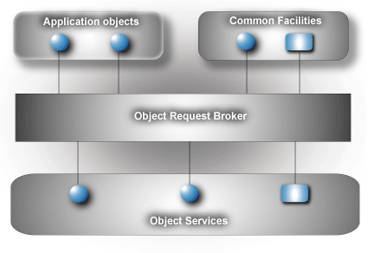
Components within the corba implementation

Slide 6
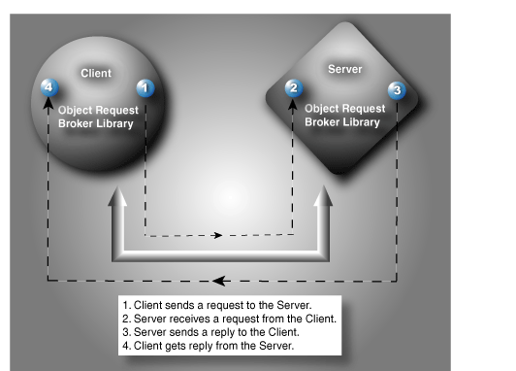

Slide 7
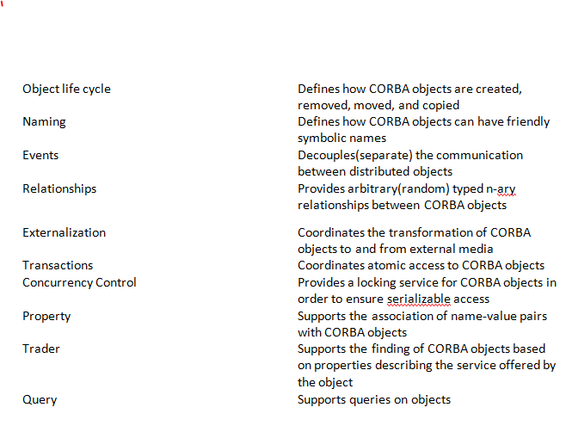
Services Of CORBA

